Slide 1

Unit 2: Lesson 2 Above and below the stairs

Slide 2
Open your book, page 34
Task 1: Sarah Feldman is a tour guide. She is an expert for the Victorian period. Listen to Sarah and number the pictures (1-7) in order as they appear.
https://www.e-sfera.hr/dodatni-digitalni-sadrzaji/32203160-c429-42c5-846d-a61f7f0da2a1/
2
1
4
3
6
7
5

Slide 3
Task 2: Listen to the text again. Are the sentences true or false?
https://www.e-sfera.hr/dodatni-digitalni-sadrzaji/32203160-c429-42c5-846d-a61f7f0da2a1/
Task 3: Make the false sentences true.
F
F
T
F
T
F
T
F
T
F
2 The family redecorated the house in the 19th century.
4 The children didn’t play in the drawing room, too.
6 The pineapple symbolized wealth and luxury.
8 Ladies never did their hair by themselves.
10 They weren’t free for the holidays.

Slide 4
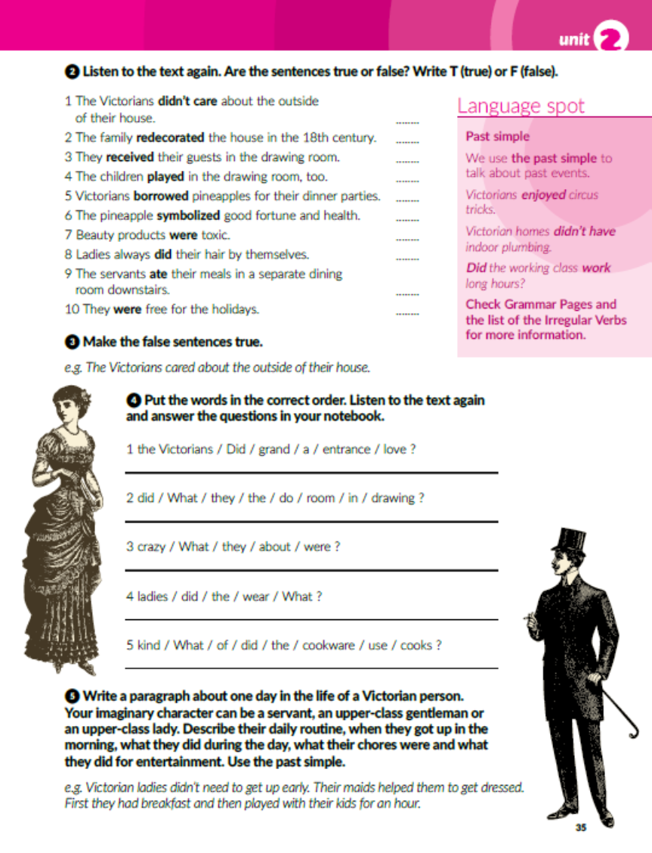
Task 4: Put the words in the correct order.
Did the Victorians love a grand entrance?
What did they do in the drawing room?
What were they crazy about?
What did the ladies wear?
What kind of cookware did the cooks use?

Slide 5
Past simple
We use past simple to talk about past events.
Form: verb + d/ed (regular verbs)
Irregular verbs have special forms (make – made).
I made pancakes yesterday.
I didn’t make pancakes yesterday.
What did you make yesterday?

Slide 6

Task 5: Write a paragraph about one day in the life of a Victorian person. Your imaginary character can be a servant, an upper-class gentleman or an upper-class lady. Describe their daily routine. Use the past simple..

Slide 7
workbook, page 29
Task 1: Write the correct number of the clothing item in the picture.
11
6
2
5
10
1
4
7
8
9

Slide 8
Task 2: Complete the sentences.
lace
entrance
redecorate
formal
maintain
cookware
antique

Slide 9
Task 3: Complete the text with the past simple form of the verbs in brackets.
Did
know
had
didn’t go
had
did
have
worked
helped
swept
died
couldn’t
wore
resembled
left
expected
Did
come
showed
got
cut
brought
put
provided
earned
found
didn’t know
did
play
made
bought
were
played
did
wear

Slide 10
Task 4: Make the sentences negative using didn’t.
Victorian children didn’t live the same way today’s children live.
Most of them didn’t go to school.
Many orphans didn’t find their families when they grew up.
Poor children didn’t play with expensive toys.
Wealthy children didn’t jump and run freely in their expensive clothes.

Slide 11
Make questions so that they match the answers.
Did you have fun at school yesterday?
What games did you play when you were little?
Did you watch TV yesterday?
What did you have for dinner last night?
What did you get for your last birthday?
When did you start learning English?
When did you last see your best friend?

Slide 12
Task 6: Present simple or past simple? Complete the text with the correct form of the verbs in brackets..
travelled
didn’t stay
live
have
stayed
spent
went
swam
isn’t
sleeps
doesn’t get
decided
warned
is
listens
didn’t listen
was
couldn’t
ran
looked
didn’t see
were
found
gets

Slide 13

LEARN MORE!
https://www.e-sfera.hr/dodatni-digitalni-sadrzaji/32203160-c429-42c5-846d-a61f7f0da2a1/

